Slide 1
Final Project Presentation SMOKING DETECTION SYSTEM Programme : B.Tech in CSE

Slide 2
Group Details
Sl.No. | Reg. No. | Name of the student | Department
1 | 16ETCS002003 | AISHWARYA.B | CSE
2 | 16ETCS002041 | GAUTAM PRADYUMNA V | CSE
3 | 16ETCS002074 | MODALI KRISHNA SAI | CSE
4 | 16ETCS002077 | MUCHAMARI MYTHRI | CSE
Batch : FT-2016

Slide 3
Title of the Project
Design and development of Smoking Detection System
Supervisors
Supervisor 1: Mr. Prakash P
Supervisor 2: Ms. Pallavi R Kumar
Place of Work Ramaiah University Of Applied Sciences

Slide 4
Outline
Introduction
Motivation(Project Concept and its relevance)
Aims and Objectives
Title, Aim, Objectives, Methods and Methodology
Problem Solving
Project Concept, Design, Development or Implementation, Testing
Outcomes-
Working Model/Prototype/Tool/Patent/ New Process/ Procedure/ Design/ Technique
Project Costing
Conclusions
References
Demonstration
Workload Allocation
Team Experience
Report Writing and Uploading Product video on YouTube

Slide 5
Introduction
Smoking detection project is undertaken to eliminate health hazards to general public through passive smoking by discouraging smoking in public place by identifying and penalizing the smoker using gesture recognition algorithm.

Slide 6
Motivation (Project Concept and its relevance)
2555 Indians are dying everyday because of tobacco related cancer.
Apart from this, almost twice the number of people are affected by passive smoking related ill health.
Tobacco is mainly consumed by “Smoking”.

Slide 7
Motivation (Project Concept and its relevance)
Steps taken by government to eliminate or discourage smoking:
High taxes on tobacco products- cigarette, beedi, cigar etc..
Statutory warning on tobacco products regarding its ill effects.
Awareness campaigns in public media(Newspaper, advertisements, hoardings).
Caution/warning in films and televisions whenever smoking scenes are depicted.
Banning of “smoking in public places”.

Slide 8
Title
Design and Development of Smoking Detection System

Slide 9
Aim
To design a system that detects smoking at public places.

Slide 10
Objectives
To perform literature survey on existing methodologies in detection of smoking.
To arrive at the system requirements.
To design the prototype for monitoring human gestures of smoking .
To train the system to detect the object and the gesture in a particular environment.
To test and validate developed system for particular test cases.
To document the report by unifying all the results and outcomes.

Slide 11
Methods and Methodologies
To perform literature survey on existing methodologies in detection of smoking.
1.1 A detailed literature survey is conducted on the existing
methods, their flaws and improvisation methods in our
proposed system is analyzed.

Slide 12
Literature Survey
TITLE | DESCRIPTION | MERITS &DEMERITS
Real-time Hand Gesture Detection and Recognition for Human Computer Interaction | The paper is about the hand gesture recognition , face subtraction and posture recognition using the SVM classifier. | Merits: The multiclass SVM classifier will be used in stage to classify the detected hand posture captured from a webcam after constructing visual words vector for keypoints of the small image (50 × 50 pixels) that contains the detected hand gesture only. Demerits: It is unable to recognize the combined gesture, hand and face at a time.
Single and Multiple Hand Gesture Recognition Systems: A Comparative Analysis | The research is all about the building model for the gesture identification both for single and multiple gestures at a time. | Merits: applications and the qualitative performance parameters to measure the efficiency. Demerits: need of gloves to differentiate between the hands and the hands should be in the camera view field.
Hand gesture recognition using support vector machine | Segmentation techniques are discussed. SVM training algorithm builds a model that predicts whether a new dataset falls into one category or other. And the classifier learns from the data points in examples when they are classified belonging to their respective categories. | Merits: SVM is used to reduce the complexity than using the neural networks. And helps in reducing the computational time. Demerits: Further feature extraction is yet to done for the hand gestures to realize the human goals.

Slide 13
Methods and Methodology
To arrive at the system requirements.
2.1 Functional and non functional requirements of the system will be derived based on the literature survey of our project .

Slide 14
FUNCTIONAL REQUIREMENTS
FR1: System should recognize hand gesture moving
towards the mouth.
FR2: System should recognize cigarette in the hand.
FR3: System should capture the photograph of the
smoker.
FR4: System should send the photograph to the
controller.

Slide 15
SYSTEM REQUIREMENTS
A high resolution web cam.
Internet connectivity.
Data storage.
Communication ID for controllers.

Slide 16
NON FUNCTIONAL REQUIREMENTS
Scalability
The system is designed in such a way that it shall be scalable to cover more number of people.

Slide 17
SOFTWARE AND HARDWARE REQUIREMENTS
SOFTWARE REQUIREMENTS:
MATLAB R2014a
Packages:
Computer Vision Tool Box
Image Processing Tool Box
HARDWARE REQUIREMENTS:
Laptop with 8GB RAM and 1TB ROM

Slide 18
SOFTWARE REQUIREMENT
MATLAB AND PACKAGES
MATLAB is a multi-paradigm numerical computing environment and proprietary programming language developed by Math Works.
MATLAB allows matrix manipulations, plotting of functions and data, implementation of algorithms, creation of user interfaces, and interfacing with programs written in other languages, including C, C++, Java, FORTRAN and Python.

Slide 19
SOFTWARE REQUIREMENT
The different packages that are used for the implementation of the specified algorithms are:
USB cam package
Computer Vision Tool Box

Slide 20
Methods and Methodology
3. To design the prototype for human gestures of smoking
Prototype should be able to monitor the human actions
3.1 Prototype should capture the background.
3.2 prototype should perform the background subtraction.
3.3 Detecting the gesture in the video frame(database / live streaming).
3.4 person’s image is captured if the person is smoking or doing any suspecious activity.
3.5 Once the image is captured , the image is saved in the database and image should be shared to the higher authorities via “G-Mail”.

Slide 21
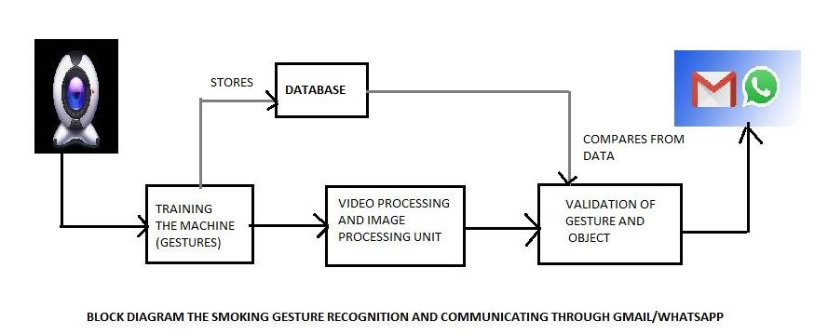
Block Diagram

Slide 22
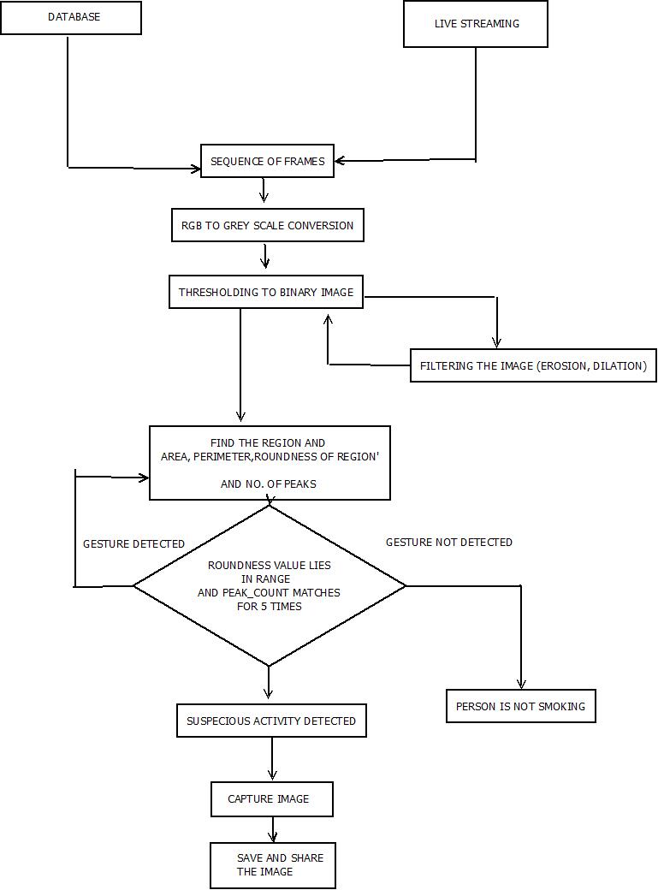
Flowchart

Slide 23
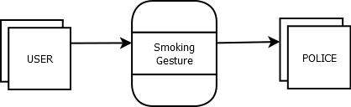
Data Flow Diagram- Level 0

Slide 24
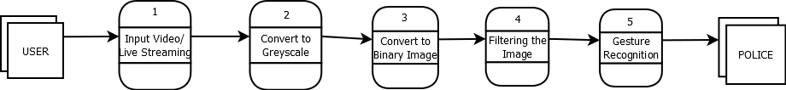
Data Flow Diagram- Level 1

Slide 25
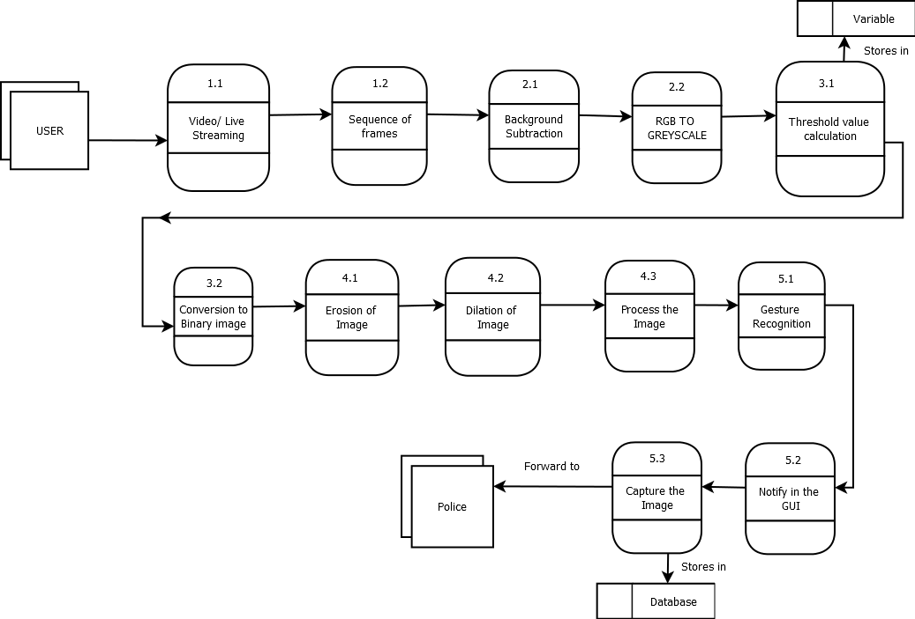
Data Flow Diagram- Level 2

Slide 26
Implementation
Language: Matlab Scripting Language
Libraries used : USB CAM and computer vision.

Slide 27
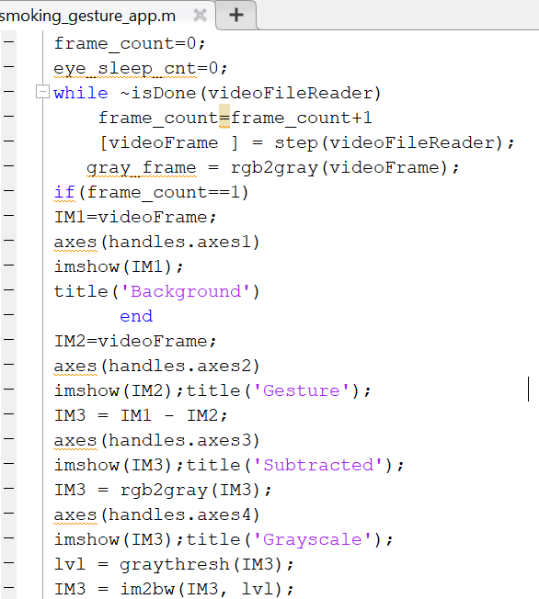
IMPLEMENTATION Code for Processing the image

Slide 28
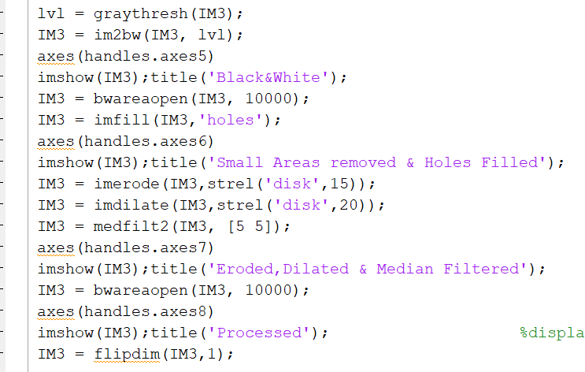
IMPLEMENTATION Code for Filtering the image

Slide 29
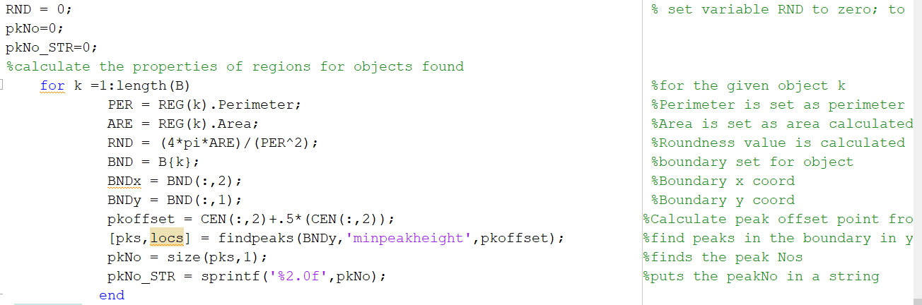
IMPLEMENTATION calculating roundness

Slide 30
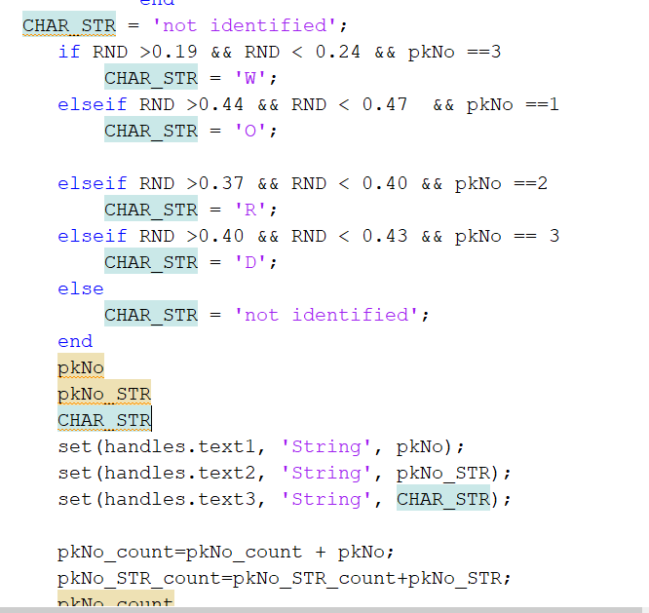
IMPLEMENTATION calculating roundness

Slide 31
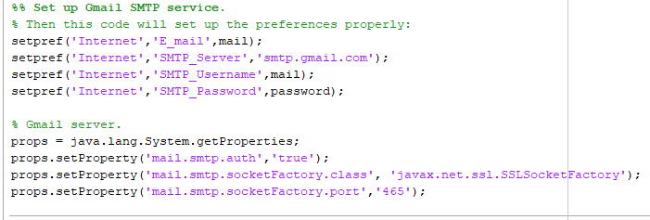
IMPLEMENTATION Code for SMTP Connection

Slide 32
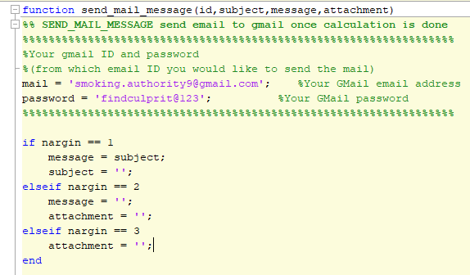
IMPLEMENTATION General Format of EMAIL Sending

Slide 33
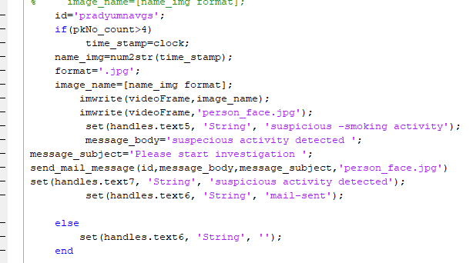
IMPLEMENTATION Code for sending an EMAIL

Slide 34
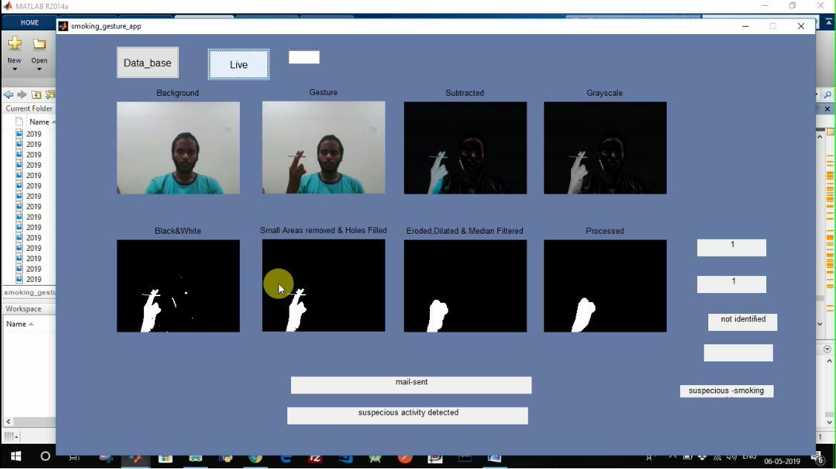
Testing Test case – 1 Smoking Gesture recognized where a person is holding cigar in his hand.

Slide 35
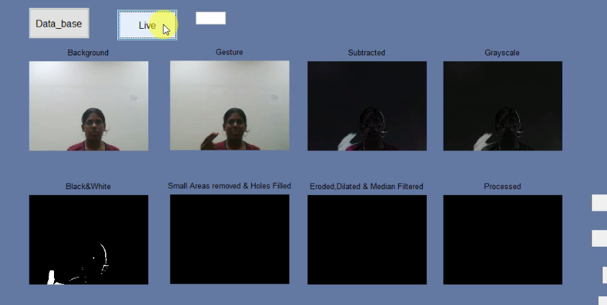
Test case -2 Gesture recognized without the presence of the object cigar

Slide 36
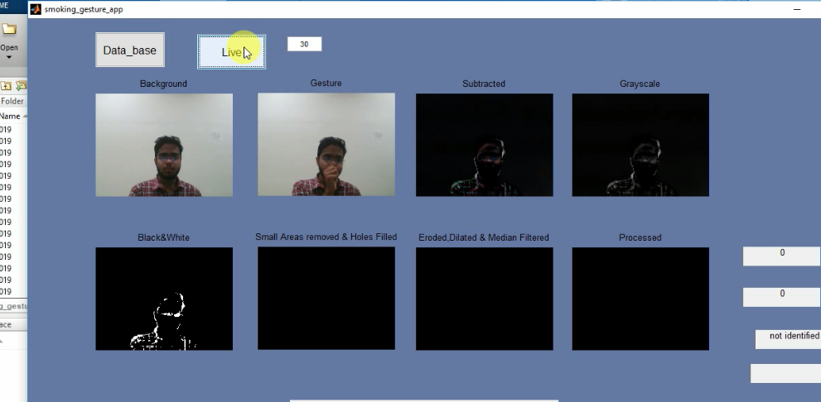
Test case -3 smoking gesture was not recognized as a person was doing some random coughing gesture.
Gesture recognized without the presence of the object cigar

Slide 37
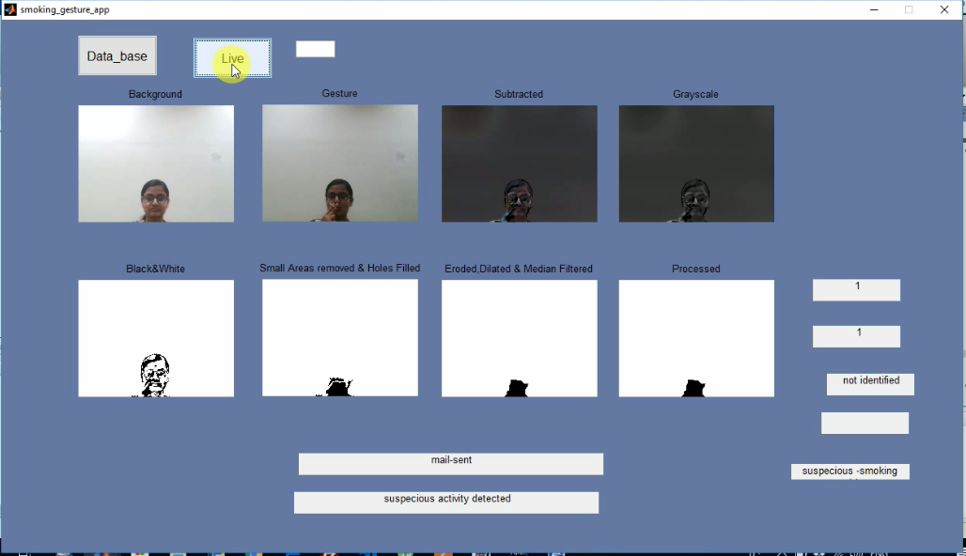
Test case -4 Smoking Gesture recognized where a person is holding cigar in his hand.
Gesture recognized without the presence of the object cigar

Slide 38
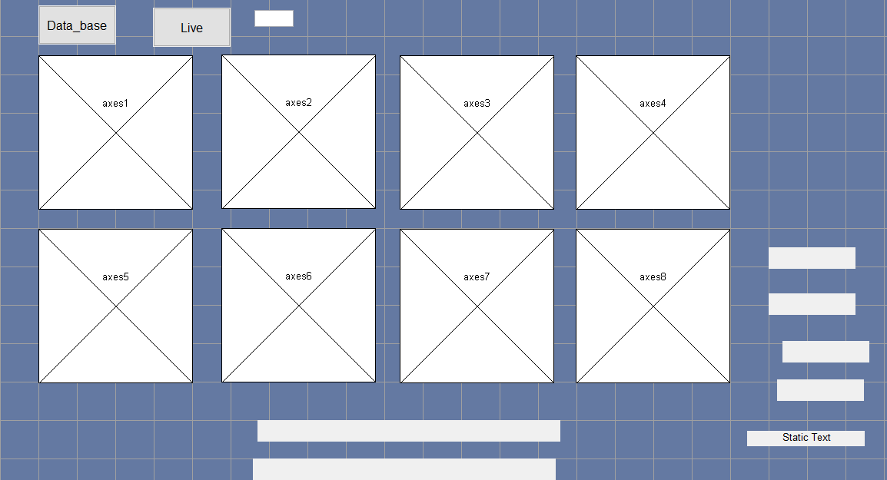
RESULTS Interface obtained on execution

Slide 39
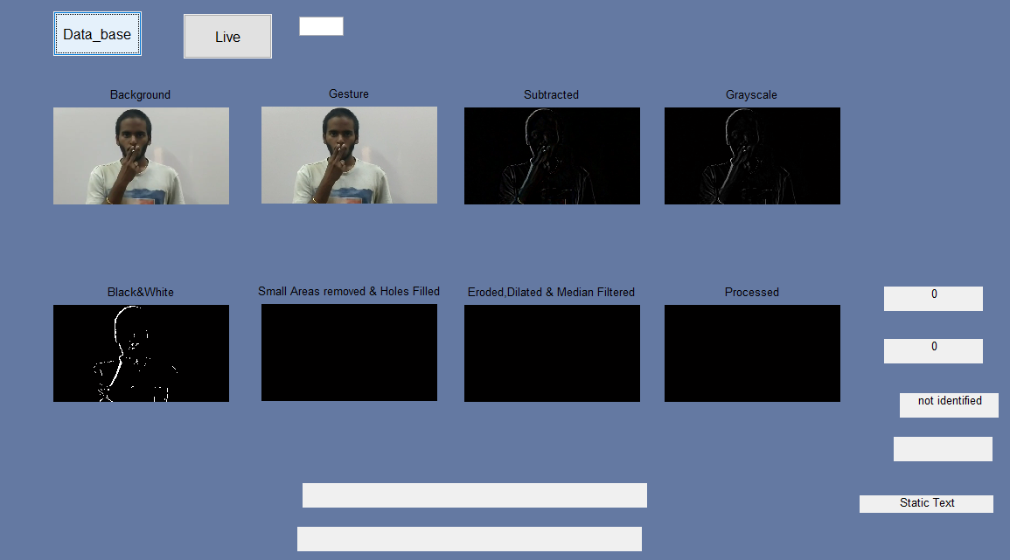
RESULTS

Slide 40
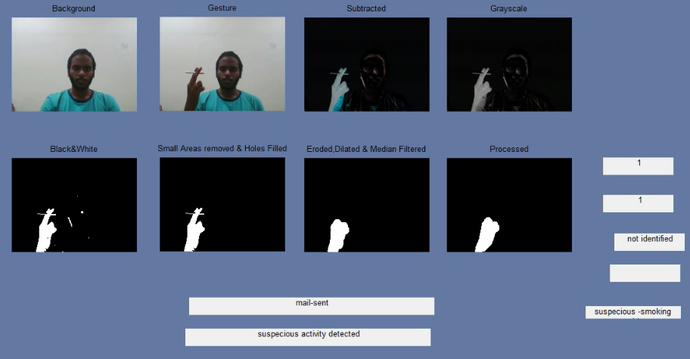
RESULTS Message displayed as mail sent and suspecious activity detected.

Slide 41
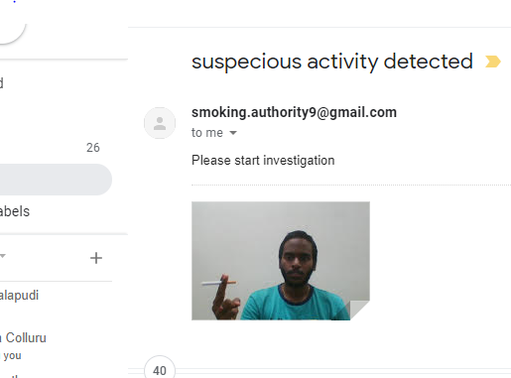
RESULTS Mail received on execution

Slide 42
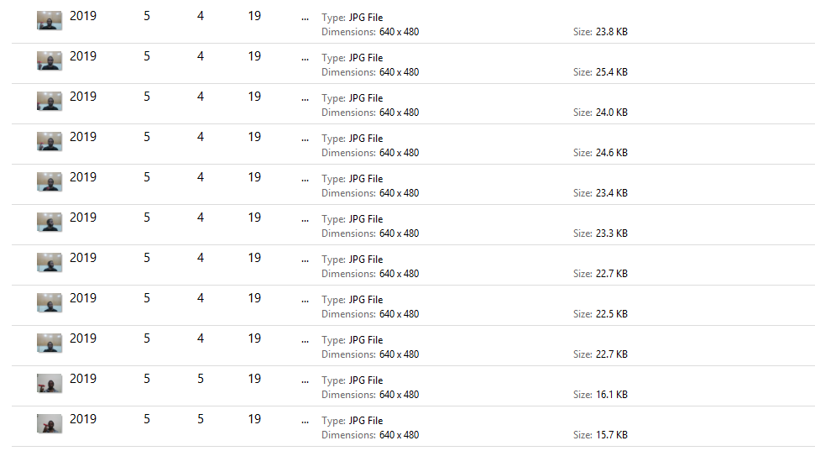
RESULTS View of Database

Slide 43
OUTCOME
The prototype was successfully implemented.
Publishing a paper.

Slide 44
Project Costing
Component | Description | Cost
Man Hours | 2 hours per day – 4 persons - 16 weeks – @ ₹ 100 per day (2 x 4 x 100 x 12 = 9,600) | ₹ 9,600
 | Total | ₹ 9,600

Slide 45
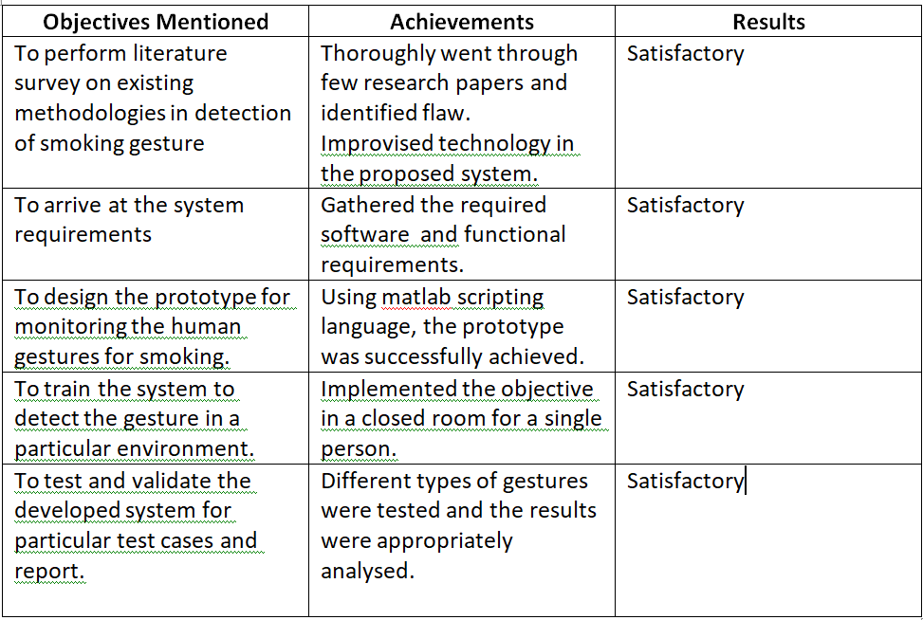
Conclusions

Slide 46
References
Siddharth S. Rautaray · Anupam Agrawal ,06 November 2012.Real-time Hand Gesture Detection and Recognition for Human Computer Interaction
Siddharth Rautaray and Manjusha Pandey , October 2014 in MECS. Single and Multiple Hand Gesture Recognition Systems: A Comparative Analysis
Michahial, Stafford. (2015). Hand gesture recognition using support vector machine. The International Journal Of Engineering And Science. 4. 42.
http://www.mecs-press.org/ijisa/ijisa-v6-n11/IJISA-V6-N11-8.pdf
http://neuralnetworksanddeeplearning.com/chap1.html

Slide 47
References
https://homepages.inf.ed.ac.uk/rbf/HIPR2/dilate.htm
https://blog.ostermiller.org/dilate-and-erode
https://www.quora.com/In-image-processing-applications-why-do-we-convert-from-RGB-to-Grayscale
https://www.pantechsolutions.net/blog/matlab-code-for-background-subtraction/
https://in.mathworks.com/help/images/ref/bwareaopen.html
http://www.labbookpages.co.uk/software/imgProc/otsuThreshold.html
https://www.youtube.com/watch?v=wcXu0Ku82Bw
https://in.mathworks.com/help/matlab/import_export/sending-email.html

Slide 48
Work Load Allocation
 | AISHWARYA.B | GAUTAM PRADYUMNA | MYTHRI M | KRISHNA
Literature Survey
Documentation
Requirements analysis
Designing
Implementation
Testing
Performance Analysis

Slide 49
Team Experience
It was very challenging since we had taken up something new which none of our team mates were aware of.
Got more awareness about real time applications and the procedures to do something regarding them.
Learnt in depth coding for a real time applications.
Our mentor served as a backbone for our project and always supported us.

Slide 50
Report Writing and Uploading Product video on YouTube

Slide 51
Thank You

